Slide 1
Weekly report: Tower structure
Week number: 06
Date: 04/11/2025
Supervisor: Prof. Faber
Group members: Ibrahim Mostafa, Mohammed Eldemerdash, Kirollos Ghaly
Speaker: Ibrahim Mostafa(770134)
03/11/2025
1
Group members: Ibrahim Mostafa, Mohammed Eldemerdash, Kirolls Ghaly
Tower structure team/ Optimus Syria

Slide 2
List of contents
Check local buckling analysis of the tower
03/11/2025
Group members: Ibrahim Mostafa, Mohammed Eldemerdash, Kirolls Ghaly
Tower structure team/ Optimus Syria

Slide 3

Check local buckling
Shell buckling (local buckling)according to EC3
$\frac{Nd}{2πRt}+\frac{Nel}{Nel−Nd}×\frac{Md}{πR^{2}t}$≤ $σ$cr
Given
Tower height H=100 m
Steel S355 → E=210 GPa=210,000 N/ ${mm}^{2}$, ν=0.30
Diameter D=4.8m⇒ R=2.4m
Design axial force Nd=9855kN
Design bending moment Md=284 000kn.m
03/11/2025
Group members: Ibrahim Mostafa, Mohammed Eldemerdash, Kirolls Ghaly
Tower structure team/ Optimus Syria

Slide 4
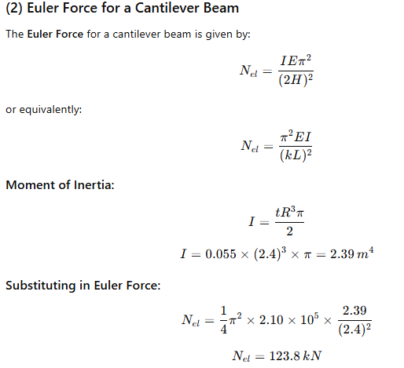
Check local buckling
03/11/2025
Group members: Ibrahim Mostafa, Mohammed Eldemerdash, Kirolls Ghaly
Tower structure team/ Optimus Syria

Slide 5
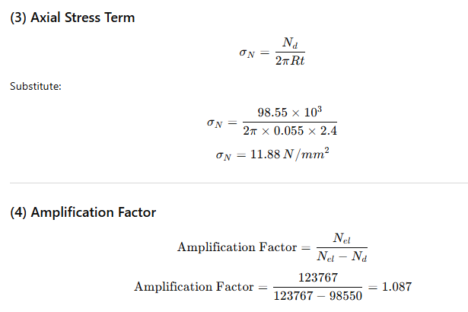
Check local buckling
03/11/2025
Group members: Ibrahim Mostafa, Mohammed Eldemerdash, Kirolls Ghaly
Tower structure team/ Optimus Syria

Slide 6
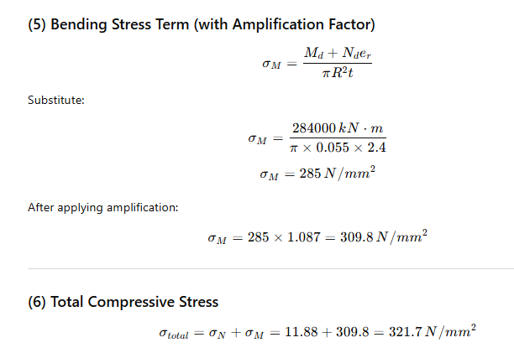
Check local buckling
03/11/2025
Group members: Ibrahim Mostafa, Mohammed Eldemerdash, Kirolls Ghaly
Tower structure team/ Optimus Syria

Slide 7
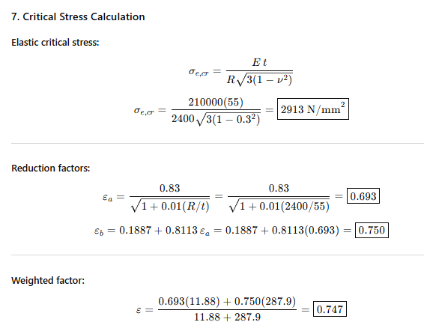
Check local buckling
03/11/2025
Group members: Ibrahim Mostafa, Mohammed Eldemerdash, Kirolls Ghaly
Tower structure team/ Optimus Syria

Slide 8
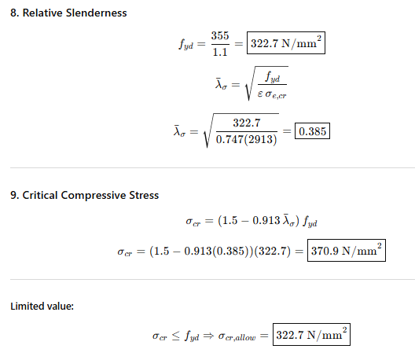
Check local buckling
03/11/2025
Group members: Ibrahim Mostafa, Mohammed Eldemerdash, Kirolls Ghaly
Tower structure team/ Optimus Syria

Slide 9
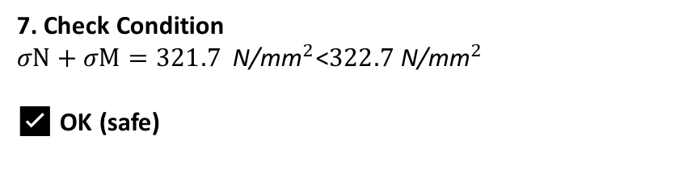
Check local buckling
7. Check Condition
$σN+σM=321.7 {\text{N}\text{/}\text{mm}}^{2}\text{<}322.7 {\text{N}\text{/}\text{mm}}^{2}$
✅ OK (safe)
03/11/2025
Group members: Ibrahim Mostafa, Mohammed Eldemerdash, Kirolls Ghaly
Tower structure team/ Optimus Syria

Slide 10
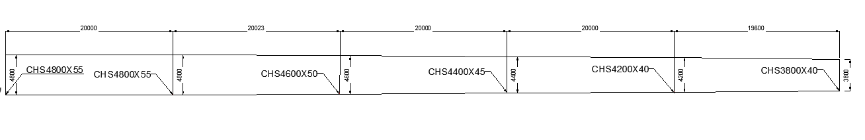
Sketch of tower dimensions
03/11/2025
Group members: Ibrahim Mostafa, Mohammed Eldemerdash, Kirolls Ghaly
Tower structure team/ Optimus Syria

